Slide 1
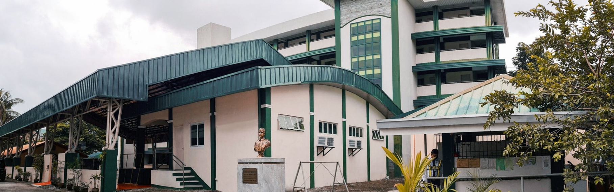
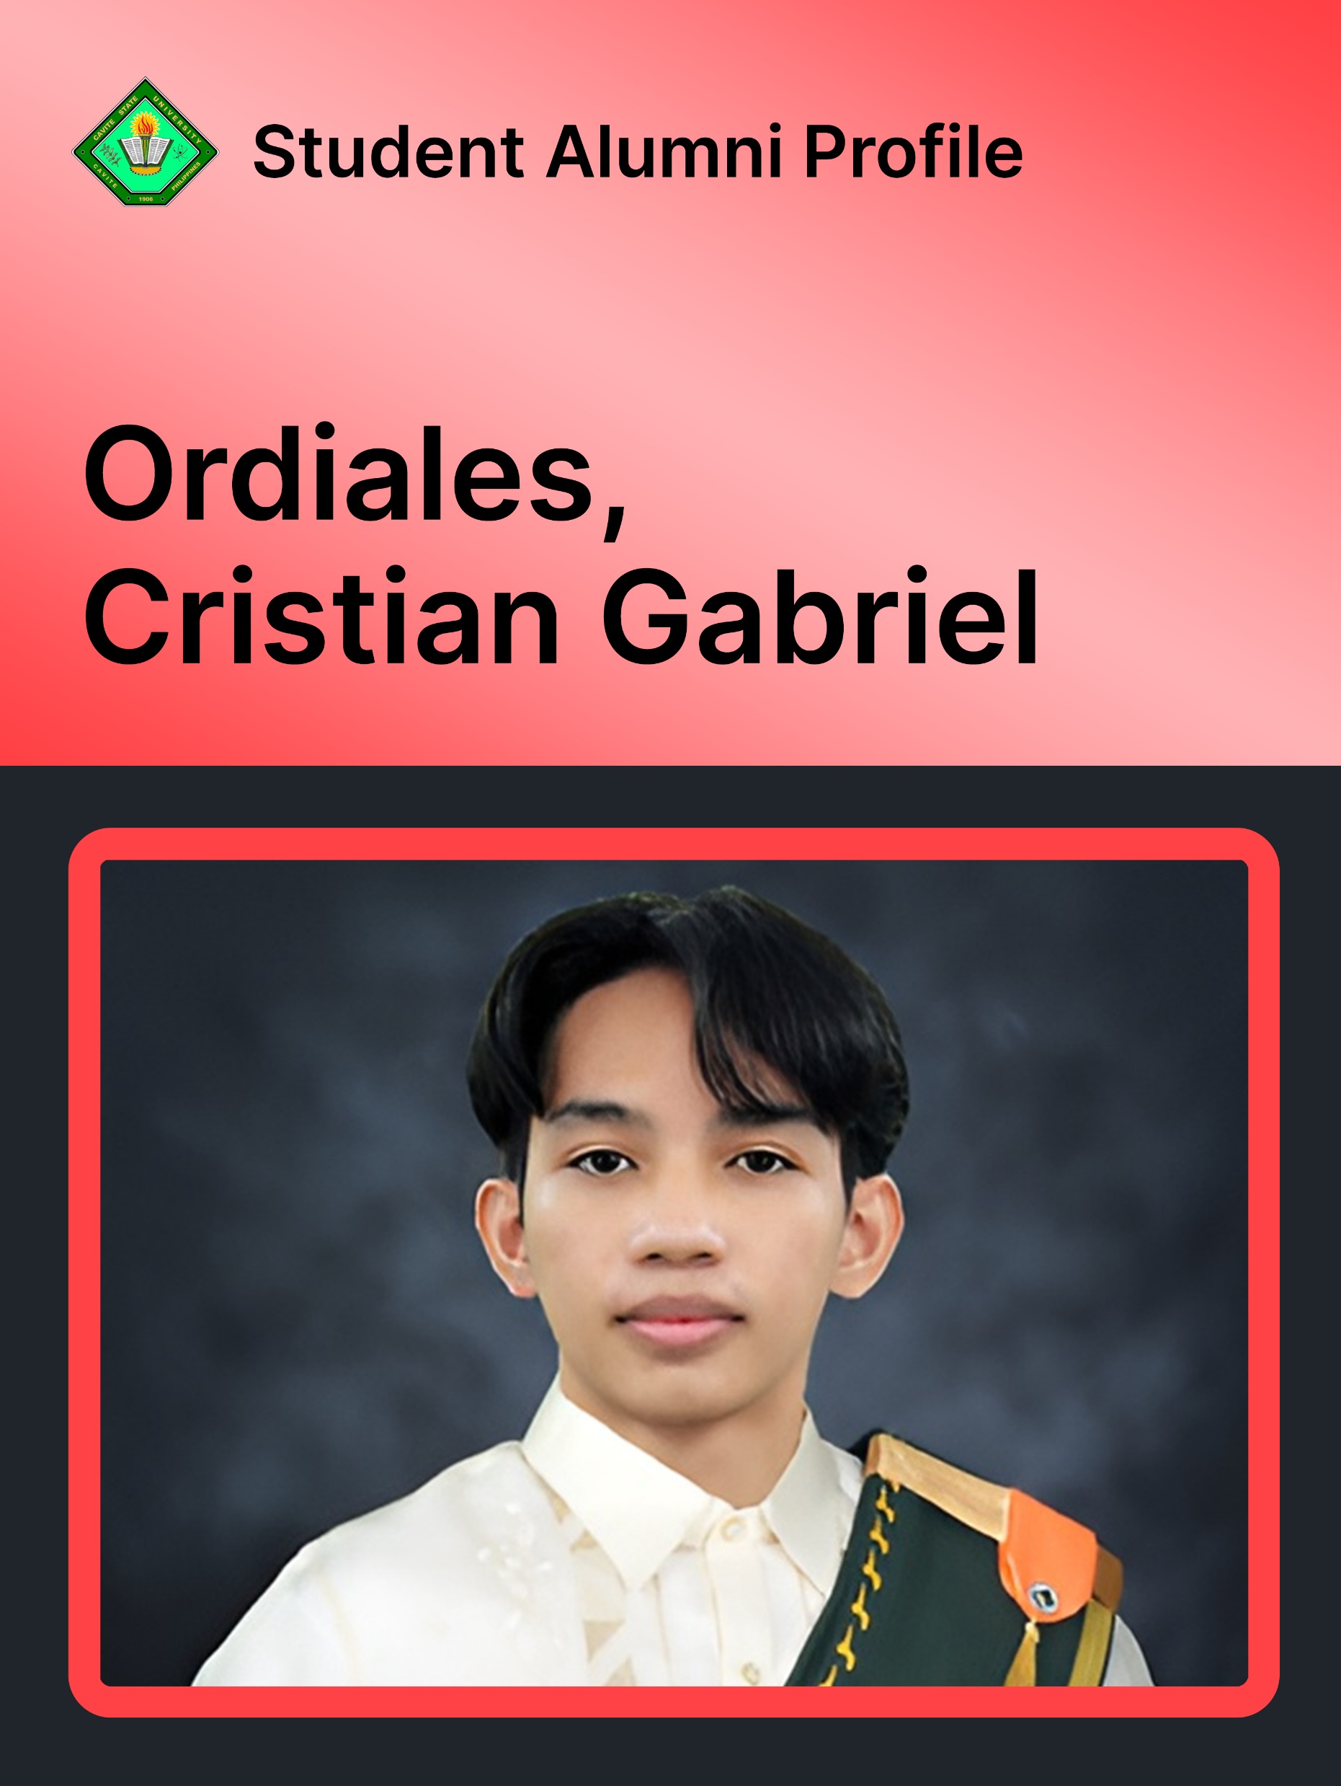
Ordiales, Cristian Gabriel
Bachelor of Science in Computer Science
PERSONAL INFORMATION:
Name: Ordiales, Cristian Gabriel
Address: Blk 76 Lot 21 23rd. Phase 11B Wellington Place, General Trias City, Cavite
Mobile No: 09913507087
E-mail: cristiangabriel.ordiales@cvsu.edu.ph
Age: 24
Birth Date: February, 10, 2004
Birth Place: Pangasinan
Civil Status: Single
Height: 5’9
Weight: 48kg
Citizenship: Filipino
Religion: Roman Catholic
EDUCATIONAL BACKGROUND:
PRIMARY: Talaba Elementary School (2009 - 2016)
SECONDARY:
1.Bacoor National Highschool (2016 - 2020)
2. St. Michael’s Institute (2020 - 2022)
TERTIARY: Cavite State University Imus Campus (October 2023 - August 2027)
STRAND: Bachelor of Science in Computer Science
SKILLS:
Computer Literate (Ms word, excel, powerpoint)
Experienced in Software Developing,
Have strong organizational skills and have effective plans in place for improvement.
A Good Listener and is always open to ideas

